Slide 1
FUNCTIONAL GROUPS IN ORGANIC CHEMISTRY
Functional groups: are special groups of atoms attached to a hydrocarbon skeleton; the most common sites of chemical reactivity.

Slide 2
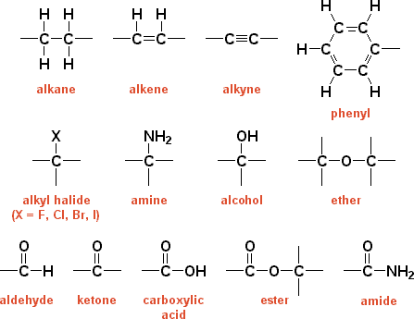
Functional groups

Slide 3
Organic halides: a hydrogen is replaced by a halogen fluoro-, chloro-, bromo-, iodo- 2-iodobutane
2,4-dibromo-1-hexene
1-bromo-2-chlorobenzene

Slide 4
Alcohols & phenols: contain the hydroxyl group (-OH) alcohols: at least 1 H on a hydrocarbon is replaced by OH phenols: at least 1 H on an aromatic ring is replaced by OH
2-propanol
3-methyl-1-butanol
1,2-butanediol

Slide 5
ethers: compounds in which an O atom is bonded to 2 organic groups: -C-O-C- methoxymethane (dimethyl ether)
methoxypropane (methyl propyl ether)
methoxybenzene (methyl phenyl ether)

Slide 6
Carboxylic acids: compounds that contain the carboxyl group (general formula is R-COOH) butanoic acid
ethanoic acid
3-methylpentanoic acid
benzoic acid

Slide 7
amines: derivatives of ammonia (NH₃) in which 1 or more H atoms are replaced by organic groups (alkyl or aryl groups)
ammonia
2-aminobutane
methylamine
1-amino-3-propylcyclohexane
trimethylamine

Slide 8
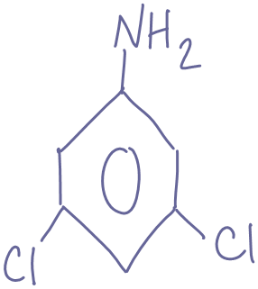
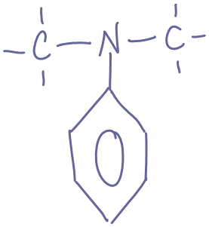
*aniline: the simplest aromatic amine
aniline
Naming it “aniline” make this carbon #1 by definition
3,5-dichloroaniline
N,N-dimethylaniline

Slide 9
IUPAC rules for naming organic compounds
IUPAC: International Union of Pure and Applied Chemistry
Rule #1: Identify the longest chain of carbon atoms
a) The longest chain of carbon atoms gives the parent name as shown in the table below:
# of C-atoms in longest chain | Stem in IUPAC name | Example (C₂H_{2n+2} for alkanes)
1 | meth- | CH₄, methane
2 | eth- | C₂H₆, ethane
3 | prop- | C₃H₈, propane
4 | but- | C₄H₁₀, butane
5 | pent- | C₅H₁₂, pentane
6 | hex- | C₆H₁₄, hexane
7 | hept- | C₇H₁₆, heptane
8 | oct- | C₈H₁₈, octane
9 | non- | C₉H₂₀, nonane

Slide 10
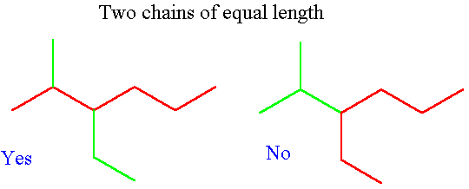
b) If two chains have equal lengths, pick the one with more branch points.

Slide 11
Rule #2: Number the carbons in the main chain
Number the chain to minimize the position/number of the following in order of priority:
if you’re naming the compound after (double bond if alkene; -OH group if alcohol, etc)
note: for multiple double bonds →-diene, -triene, -tetraene
first branch/substituent group
If both ends have the same first branching number, then number chain to minimize position of second branch (and then third and so on).
minimize the # of substituent group that comes first alphabetically
Note: in cyclic and aromatic (benzene derivatives) compounds, no number is needed if there is only one substituent.

Slide 12
Rule #3: Identify the functional group and attach appropriate suffix
Indicating position of the functional group: shown by a number inserted before the functional group ending. The number refers to the carbon atom to which the functional group is attached when the chain is numbered starting at the end that will give the smallest number to the group.

Slide 13







Class of compound | Functional group | Suffix in IUPAC name
alkane |  | -ane
alkene |  | -ene
alkyne |  | -yne
alcohol |  | -anol
aldehyde |  | -anal
ketone |  | -anone
carboxylic acid |  | -anoic acid
amine |  | -anamine

Slide 14
Rule #4: Identify the side chains or substituent groups Assign number of carbon at point of attachment.
Side chain/ substituent group | Prefix in IUPAC name | Example
-CH₃ | methyl- | 2-methylpropane
-C₂H₅ | ethyl | 3-ethylpentane
-C₃H₇ | propyl- | 4-propylheptane
-F, -Cl, -Br, -I | fluoro-, chloro-, bromo-, iodo- | tetrachloromethane
-NH₂ | amino- | 2-aminoethanioic acid

Slide 15
Rule #5: Assemble name as a single word → numbering, substituent, parent/main chain, suffix
List substituents alphabetically (i.e. butyl- before methyl-)
If multiples of one substituent are present: “di-,” “tri-,” “tetra,” etc.
Note: “di-,” “tri-,” “tetra,” etc. aren’t part of alphabetical name (triethyl- before dimethyl-)
punctuation: commas between numbers; hyphens between numbers and letters; merged into one word

Slide 16
Identify the IUPAC name of the following:

Slide 20
Geometrical Isomerism

Slide 28
Reactions involving alkynes
Syn Hydrogenation of an alkyne
If the atoms are added on the same side of the molecule then the addition is said to be a "syn" addition. If the added atoms are added on opposite sides of the molecule then the addition is said to be an "anti" addition.

Slide 29
4. Halogenation of Alkynes

Slide 31
The Chemistry of Aromatic Compounds
Arene: A compound containing one or more benzene rings.
Benzene
Aryl group: When we remove a H atom from an arene (Ar-).
Phenyl C₆H₅-

Slide 32
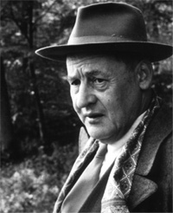
Aromaticity
For a molecule to be aromatic it must satisfy:
Planarity rule
Be cyclic
Have a p-orbital on every atom in ring
Be planar
Hückel’s rule
Posses 4n+2 π electrons = number of Pi electrons in the ring
Wehere n must be a whole number
n= 0, 1, 2, 3………
Erich Hückel

Slide 33
Are they Aromatic Molecules?
Are the following structures aromatic?
Cyclic? P-Orbital? Planar? 4n+2 π electrons?
Which is Aromatic?
Draw Resonance Structures if so!

Slide 34
Which of the following are Aromatic?
:
•
4 e⁻
4 e⁻
5 e⁻
6 e⁻
:
•
does not have p-orbitals on all atoms
8 e⁻
7 e⁻
6 e⁻

Slide 35
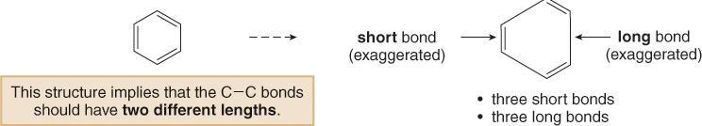
Properties of Benzene and its derivatives
The Structure of Benzene
Any structure for benzene must account for the following facts:
It contains a six-membered ring and three additional degrees of unsaturation.
It is planar.
All C—C bond lengths are equal.
The Kekulé structures satisfy the first two criteria but not the third, because having three alternating π bonds means that benzene should have three short double bonds alternating with three longer single bonds.

Slide 36
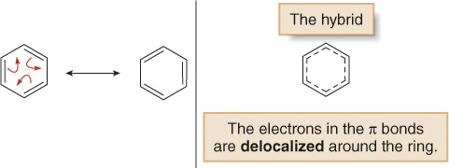
The Structure of Benzene
The resonance description of benzene consists of two equivalent Lewis structures, each with three double bonds that alternate with three single bonds.
The true structure of benzene is a resonance hybrid of the two Lewis structures, with the dashed lines of the hybrid indicating the position of the π bonds.
We will use one of the two Lewis structures and not the hybrid in drawing benzene. This will make it easier to keep track of the electron pairs in the π bonds (the π electrons).

Slide 37
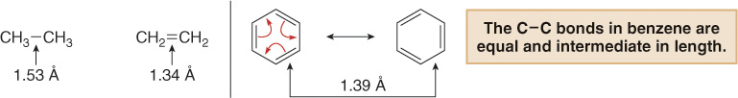
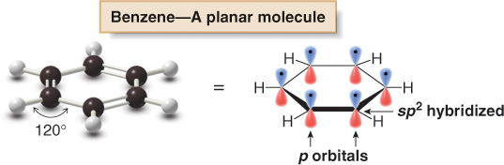
The Structure of Benzene
In benzene, the actual bond length (1.39 Å) is intermediate between the carbon—carbon single bond (1.53 Å) and the carbon—carbon double bond (1.34 Å).

Slide 38
Nomenclature of benzene derivatives
Aromatic compounds are named:
With benzene as the parent chain.
Name of substituent comes in front of the “benzene”.
methylbenzene chlorobenzene ethylbenzene
CH₃
Cl
CH₂-CH₃
Some substituted benzenes have common names.

Slide 39
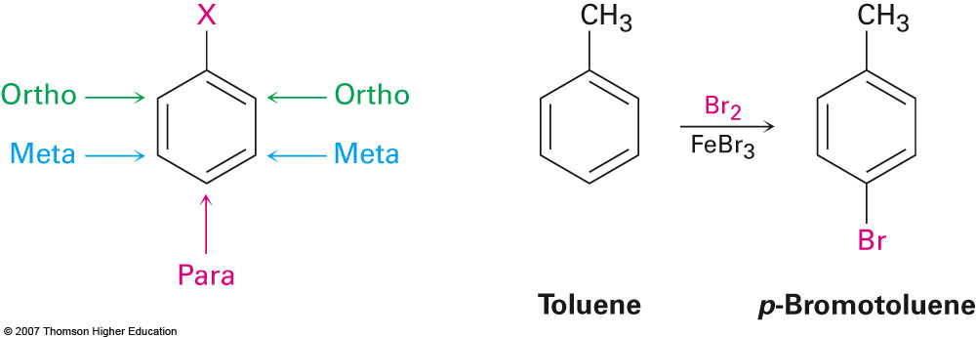
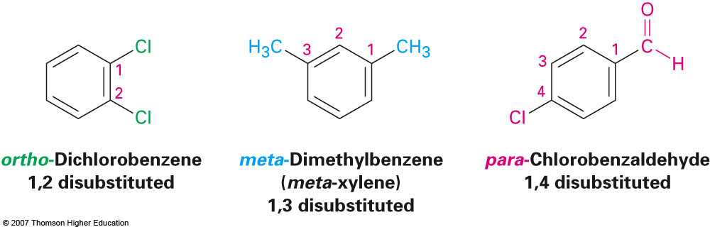
Disubstituted Benzenes, Nomenclature
Relative positions on a benzene ring
ortho- (o) on adjacent carbons (1,2)
meta- (m) separated by one carbon (1,3)
para- (p) separated by two carbons (1,4)
Describes reaction patterns (“occurs at the para position”)

Slide 40
Nomenclature ct’d……
Two identical substituents: di- (3: tri- etc.)
Numbering of C atoms in ring

Slide 41
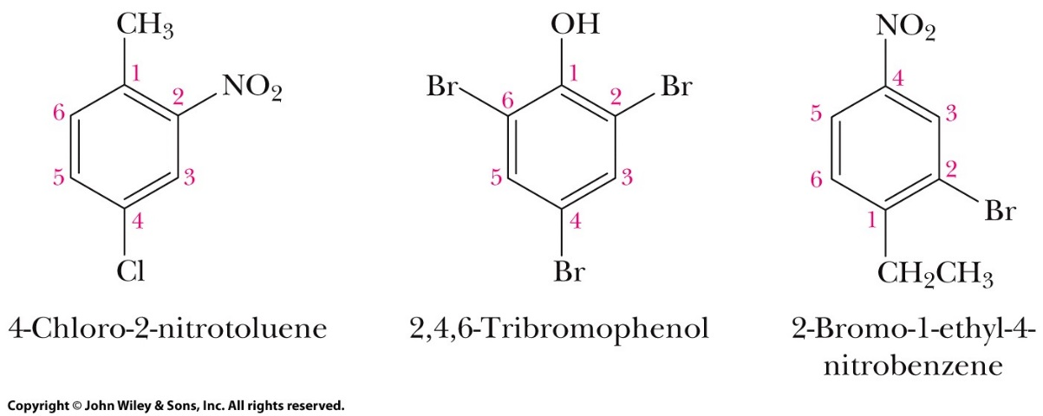
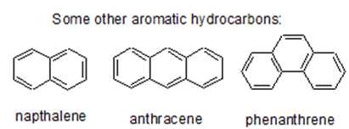
Nomenclature, ct’d...
Polysubstituted benzenes
With three or more substituents, number the atoms of the ring.
If one group imparts a special name, it becomes the parent name and the group branches from carbon 1.
If no group imparts a special name, number to give the smallest set of numbers, and list alphabetically.

Slide 42
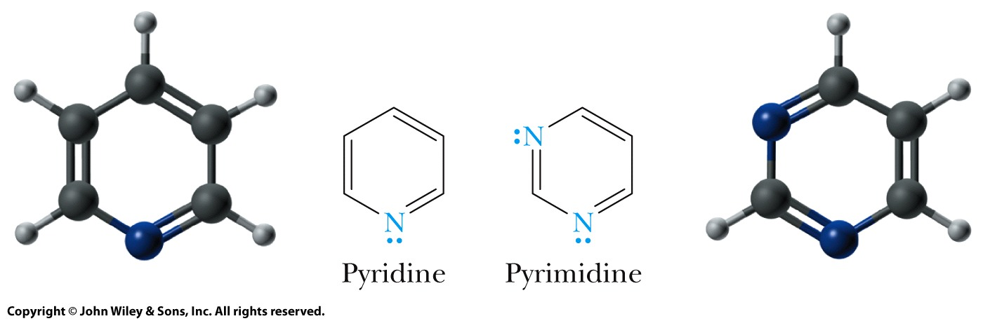
Heterocyclic Aromatic compounds
Heterocyclic compound: A compound that contains one or more atoms other than carbon (heteroatoms) in its ring (nitrogen, oxygen, sulfur, etc…).
Heterocyclic aromatic compound: A heterocyclic compound whose ring is aromatic.
Pyridine and pyrimidine are heterocyclic analogs of benzene; each is aromatic.

Slide 43
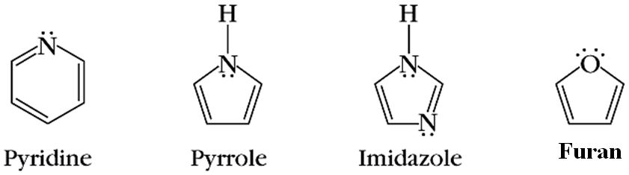
Other heterocyclic aromatic compounds

Slide 44
Directing effects of substituents on benzene ring
Activating Directors
Any resonance effect for electron-donating groups such as –NH₂,–OH, and –OR, which delocalizes the positive charge on the cation intermediate, lowers the activation energy for its formation and activates the ring toward further EAS.
These groups on the benzene ring make electrophilic aromatic substitution faster.
They direct substitution to the ortho and para positions.
For ortho-para directors, ortho-para attack forms a more stable cation than meta attack.

Slide 45
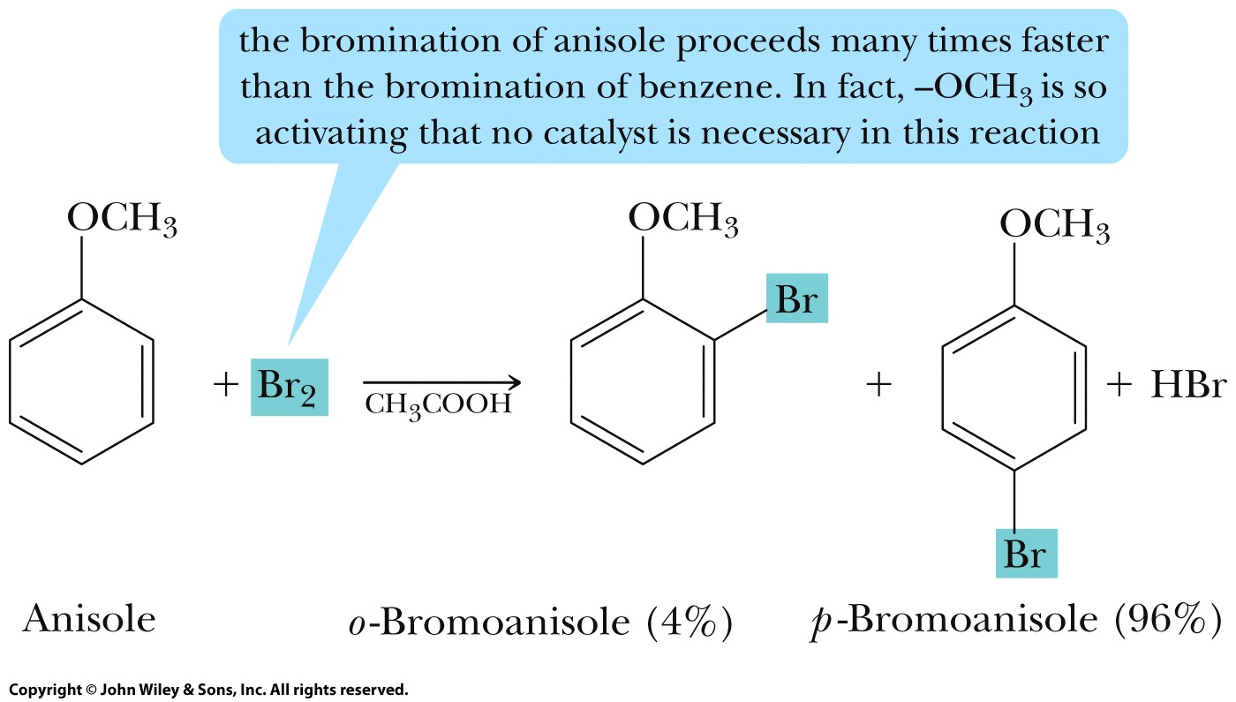
Activating Directors

Slide 46
Activating Directors
toluene
R (alkyl) groups are weakly activating and ortho- & para-directing.
Toluene reacts 25 times faster than benzene in nitration
aniline
phenol
Note – no catalyst
-NH₂, -OH, -OMe, MeCONH- are all powerful activating groups
Ortho- and para- directing

Slide 47
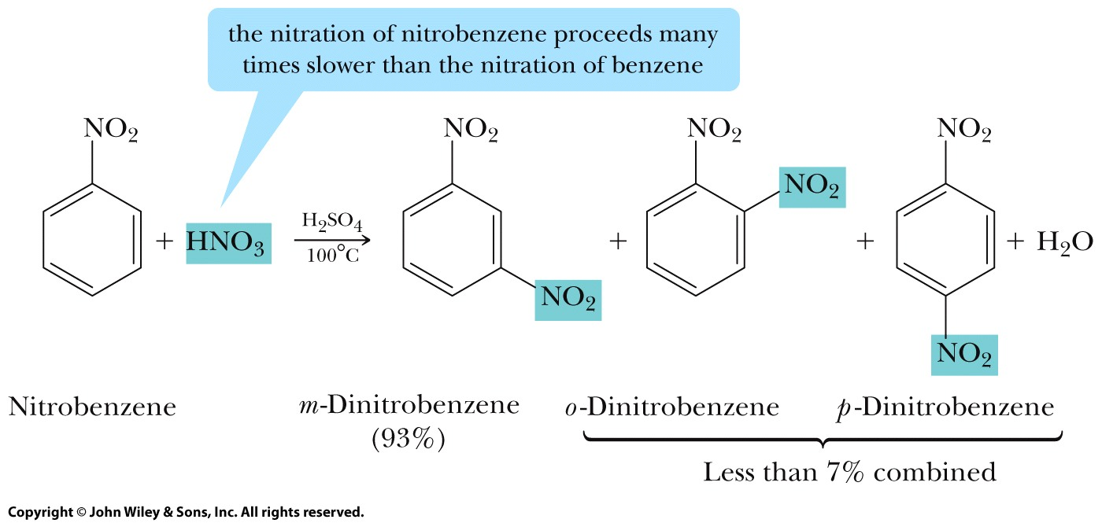
Deactivating Directors
Any resonance or inductive effect for electron-withdrawing groups such as –NO₂, –C=O, -SO₃H, –NR₃⁺, –CCl₃, and –CF₃, which decreases electron density on the ring, deactivates the ring toward further EAS.
These groups on the benzene ring make electrophilic aromatic substitution slower.
They direct substitution to the meta position.
For meta directors, meta attack forms a more stable cation than ortho-para attack.
Also, meta products are formed faster than ortho-para products.
-NO₂ is meta directing.

Slide 48
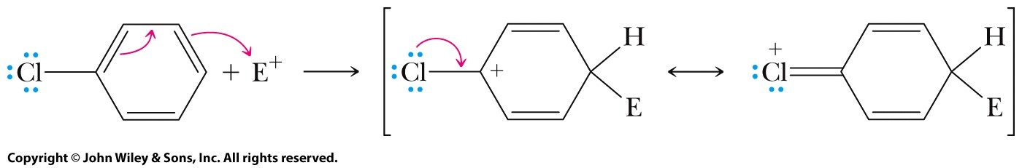
Deactivating Directors
Halogens: the resonance and inductive effects operate in opposite directions.
The inductive effect: halogens have an electron-withdrawing inductive effect; therefore, aryl halides react more slowly in EAS than benzene.
The resonance effect: a halogen ortho or para to the site of electrophilic attack stabilizes the cation intermediate by delocalizing the positive charge; halogen, therefore, is ortho-para directing.

Slide 49
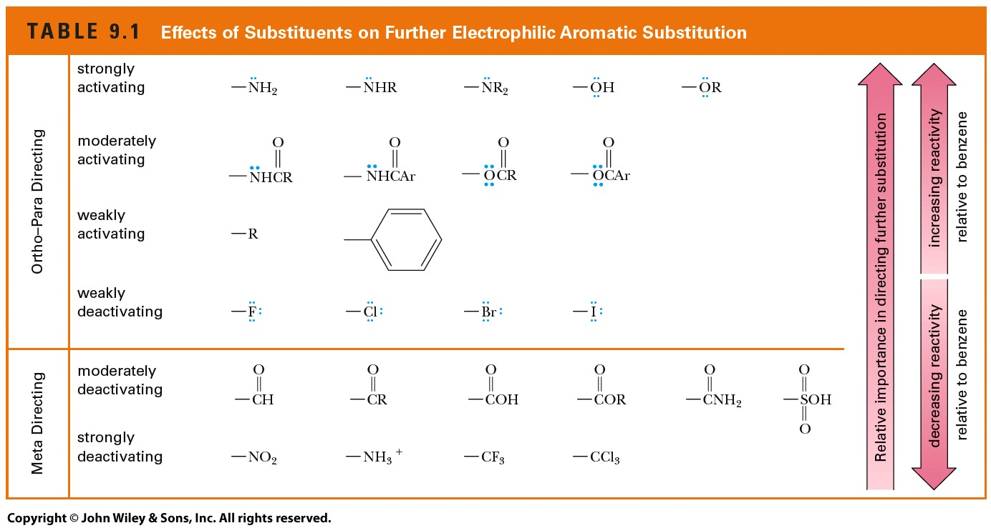
Summary
Groups which are ortho-para directing.
Alkyl groups, Phenyl groups and,
Substituents in which the atom bonded to the ring has an unshared pair of electrons
All ortho-para directing groups are activating toward further substitution; except halogens, which are weakly deactivating.
All other substituents are meta directing.
All meta directing groups carry either a partial or full positive charge on the atom bonded to the ring.

Slide 50
Alcohols and Ethers

Slide 59
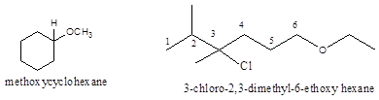

Slide 70
